Slide 1
Fitness First
Reece Davis
Nick Ronci
Jordan Scott
Christopher Harpster

Slide 2
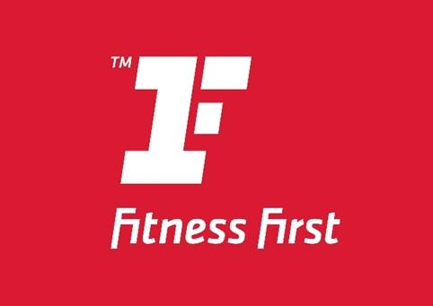
Introduction
Notes:
Whenever you click the picture when you when you present, it should show the video on the site. After the video is done, just click the X to x the tab then click return to full screen for the full presentation
“fitness affordable to everybody”
http://www.youtube.com/watch?v=X0zqpobmMIQ

Slide 3
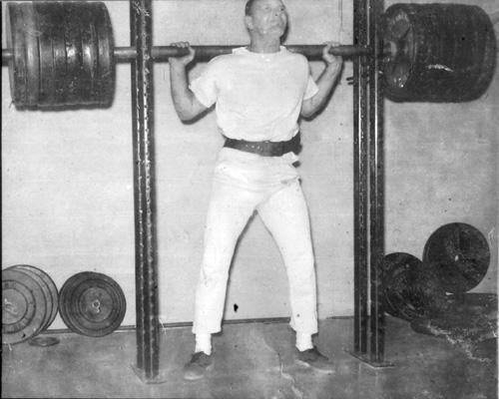
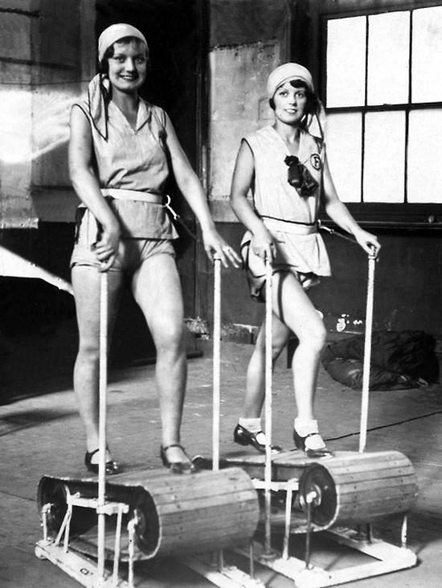
History
Started out as Health Spas
Featured some fitness equipment
Notes:
In the early 1960’s, fitness centers were known as Health Spas. These Health Spas included whirlpools, steam rooms, and message services. The Health Spas did feature some fitness equipment, stated from my source on Reference For Business, like “manual joggers, stationary bicycles, standard resistance machines for men, and passive resistance equipment for women.”

Slide 4
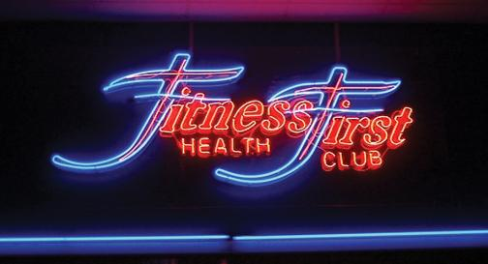
Company Background
Fitness First started in 1993
Founded by Mike Balfour
Financial Trouble
Sold Fitness First
multiple times
Current CEO:
Andy Cosslett took
over in 2012
Notes:
Fitness First was founded by Mike Balfour in 1993. Only after 3 short years, the company started to expand rapidly from all across the UK to Belgium and Germany. The company continued to expand a few years after to places such as Australia, Spain, France, Italy, and more. With the unexpected rapid growth over the years, it caused Fitness First to get into some financial trouble. The company had to be sold to the company, Cinven. In 2004, the company reached a big milestone, their one-millionth member. Unfortunately, Fitness First had to be sold again in 2005 to the private equity group, BC Partners for the business to stay afloat. The business continued to expand to the Middle East and India. In 2011, Fitness First had been stated to be the “world’s largest private health and fitness club operator”. This was a huge accomplishment for the company. The company at the time operated over 470 clubs with around 1.3 million members. In 2012, Andy Cosslett stepped in as the Chief Executive Officer of Fitness First. Till this day, he is trying his best to rewrite the rules of fitness and improve the company everyday. He not only wants to maintain the title of world’s largest private health and fitness club operator, but to consistently grow in a positive manner. Reece is going to talk about the UK Health Club Industry

Slide 5
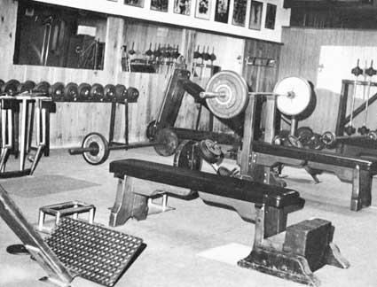
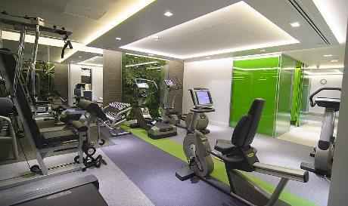
The UK Health Club Industry
Old gyms vs. New gyms
Start-ups → Grow w/ Venture Capital funds
Established companies also entered the industry
Established organizations entered.
Why?
Notes:
Old time gyms were geared primarily toward men. They had limited equipment and basic locker room situations. Whereas, the new gyms, or health clubs, featured advanced equipment, access to personal training consultation, and relaxation activities such as steam rooms or sauna’s.
The first companies to enter the health club industry were typically start-ups. Growing using venture capital funds. Fitness First was one of these start-ups. Established companies also entered the industry. An example is when Virgin Group entered the industry by acquiring South Africa’s Health and Racquet Club in ’92. Why would an established organization take the risk of entering the Health Club industry? Because the industry was viewed as a growth industry. Franchise chains were also established, several of them being international.
Old gym picture reference: Davedraper.com/siteimages/vinces.jpg
New gym picture reference: ehotelier.com/hospitality-news/item.php?id=A20290_0_11_0_C

Slide 6
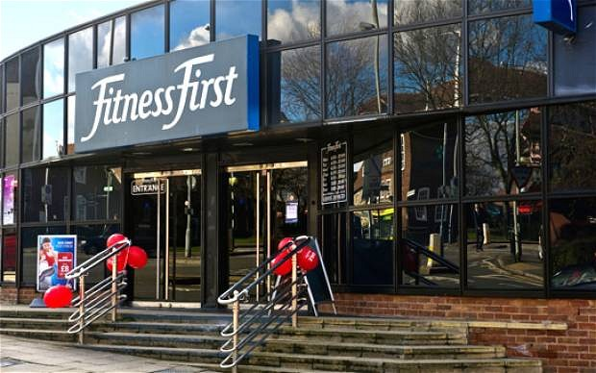
Facilities, Costs, & Pricing
Two different clubs/Same owner
Fitness first (UK)
Nuffield Health Fitness & Wellbeing
Membership Pricing for Fitness First
Facilities
Different Tier Systems/$$
More flexibility
Corporate Costs
Different Payment Plans
Notes:
Because of the gyms being more focused on men it caused problems with business. As the gyms started to develop starting with Fitness First, there became a hunger for more attraction for customers. The people that headed the fitness clubs started using strategic goals and attractions to create a more friendly environment for others who were thinking about joining and didn’t because of the images set up by traditional gyms. Two gyms that I would like to discuss would be Fitness First in the UK and Nuffield Health Fitness and Wellbeing club. Both are owned and operated by BC Partners, but have different strategic focuses and payment plans as well as different forms of flexibility.

Slide 7
Facilities, Costs, & Pricing
Membership Pricing for Nuffield…
Rewards
Corporate Wellbeing
More Focused on Older People
Facilities
Pools, Squash Courts, Saunas, etc…
Similar to Virgin Active
Notes:
Nuffield focuses on an older group. Not as much flexibility, but have different rewards. The facilities are also not as vast because older people would not be into using so many vast options. Non-profit.

Slide 8
Recent Developments
2007-2009 Financial Crisis
Membership static at 4.4 million members
Declining retention outweighs new members
More competition in the market
Emergence of low cost gyms
EX: Gym Group, Pure Gym
Notes:
After the 2007-2009 financial crisis, people were looking to cut down their spending and fitness was one of those. People looked at fitness as a luxury and not necessarily a necessity. Because of this, membership at fitness clubs in all of the UK was static at around 4.4million. Even though membership was static, companies were expanding the number of clubs they wanted to open. The UK economic growth would remain sluggish for the some time in the future.
Membership renewals were greater than the new members that fitness clubs were getting. The fitness clubs were facing a dilemma of how to retain members while at the same time acquire new memberships. Since 2000, gyms were consolidating with other gyms in order to strengthen their market share. For example, Virgin Active acquired Holmes Place Chain and David Leisure merged with Next Generations.
Fitness First also faced the emergence of low cost gyms. The numerous low cost clubs would drastically increase the competition among the different tier fitness clubs. Pure Gym built 15 clubs during 2011 and 2012 with the intention of expanding to 45 in the future.

Slide 9
PEST Analysis
Political
May 2011 court ruling
Economic
2007-2009 Financial Crisis
Social
Health conscious society
Technological
Newest equipment
Notes:
PEST Analysis
Political
-In May 2011, a court ruling decided to declare membership contracts of more than one year unenforceable. This would lead to
Economic
-During the financial crisis,
Social
Technological
Picture: Agoda.com

Slide 10
Case Question #1
How attractive is the UK health and fitness club industry in terms of its profit potential?
Consolidation in the industry
Factors
Value of product to consumer
Intensity of competition
Bargaining power of producers
To really answer this question we must analyze Porter’s Five Forces!
Notes:
Profit Potential?
While the industry is consolidating, reducing the number of competing companies; “Low-cost/Budget” health club numbers are increasing. During 2011 and 2012 Pure Gym, a low-cost health club planned to grow from 15 to 45 clubs. According to the Foundations of Strategy book the profits earned by the firms in an industry are determined by these factors:
-The value of the product to customers
>Health clubs are considered a luxury by customers, because recession and the threat of
recession causes them to leave
-The intensity of competition
>With organizations such as Pure Gym competing from a low-cost point
-And the bargaining power of the producers relative to their suppliers
>Now health clubs have to pick a segment of the industry to specialize in. Target certain
‘markets’
>Cost of equipment needs to stay low:
-Customers want advanced equipment, but each piece of equipment can cost
£20,000

Slide 11
Case Question #1 Cont’d
Apply Porter’s five forces of competition framework to the industry to justify your answer.
SUPPLIERS
POTENTIAL ENTRANTS
Industry Competitors
SUBSTITUTES
BUYERS

Slide 12
P5F Framework & Fitness First
Saturated market
Exception: Low-Cost HCs
Substitutes
Diet Pills
Home workouts
Buyers & Suppliers
Quality
Competitive Intensity
Notes:
Potential Entrants:
The market is saturated. The only exception is the low-cost health clubs
-As previously mentioned, as recently as 2011 and ’12, Pure Gym is planning a large
expansion in the UK.
Because there are no restrictions, profits will stay at a competitive level.
And the threat of entry keeps prices competitive
Substitutes:
-Fitness First has close substitutes and when you have close substitutes customers will switch in
response to price increases.
Established Competitors:
-As far as the Diversity of competitors is concerned, some companies in the industry are similar,
yet some are different. This is another way that the industry is changing. New types of
competitors, the low-cost health clubs that are entering, and existing competitors, the public
health clubs are intensifying competition.
-During the recession the health club industry suffered form members not renewing their
memberships creating excess capacity in the industry.
Bargaining power of Buyers:
-Buyers in the health club industry comes from the quality of the machines and services offered.
Customers/Members expect certain machines or services and if Fitness First doesn’t offer
those services the customer will go elsewhere.
Not much to say on the Bargaining Power of Suppliers

Slide 13
Case Question #2
How might this industry be segmented? Advise Fitness First on segments that appear most attractive.
Age
Income
Sports
Quality
Price

Slide 14
Case Question #3
In what ways might Fitness First influence the course of the industry’s evolution to its own advantage?
Owns the most clubs in the UK
Leads the market in membership
Newest workout equipment
Customer oriented
Notes:
Owns the most clubs in the UK:
Leads the market in membership:
Since Fitness First currently

Slide 15
Case Question #4
What do you think are the key success factors in this industry?
What do the customers want?
Analysis of demand
How does the firm survive competition?
Analysis of competition
Notes:
What are the key successes factors in this industry? To answer this, we need to answer a few questions. What do customers want? Their main customers are people, from the ages of early 20’s to mid-40’s, who are looking to get fit whether it is by lifting weights, cardio workouts, swimming, etc. Customer’s age also ranges to 50’s and higher. Their customers are looking for top of the line equipment to satisfy their fitness needs. How does the firm survive competition? What drives the fitness industry competition is the amount of new entry fitness clubs in the industry. More and more fitness clubs are opening worldwide. Competition is becoming slightly more intense over the years because of the many new clubs opening. Fitness is becoming a bigger part of people’s lives so they are trying to find the fitness club that is perfect for them. Many of these new clubs are coming in with a lower membership fee to meet the need of the customer’s desire to save money. This has caused competition to increase immensely. The way Fitness First can obtain a superior competitive position is by maintaining the continuous improvement on the fitness equipment. Fitness First is a firm believer in providing the best to their customers. The company always tries to provide the best equipment out there to satisfy their members. Fitness First till this day is the world’s largest fitness club operator, so they can continue to use their status as a symbol of superiority over their competition.

Slide 16
Recommendations
Build the “product”
Don’t move into low-cost gyms
Comparison Ex: Apple vs. Dell
Superior products and services
Comparison Ex: Paccar
Customer Retention
Customer Loyalty Program
Discount
Referrals
Notes:
We came up with some recommendations that we believe would be beneficial to Fitness First. First, we recommend for the company to build their product. Fitness First does not need to move themselves into a low-cost membership gym to save money. As a comparison, you can look at Apple and Dell. Dell is known for their relatively lower price and lower quality computers. Comparing to Apple, who charges more while maintaining a high quality computer and is known as a status symbol. Apple is one of the most successful businesses in America with this strategy and Fitness First could do this as well.
Product Area:
-Do not try to compete with the low-rent health clubs. Leave the budget gyms to the companies already in
that segment of the industry.
Customer Retention:
-With the level of competition putting pressure on lower membership fees Fitness First must keep
revenues up without losing new member sign ups. Also, with the multiyear membership deals no longer
allowed some incentive for members is necessary.
-Offer incentives such as a discount for being there a year or longer. Include something such as guest passes for a day. If a member refers someone to FF they get a month free membership or a gift card or something

Slide 17
Multiple Choice
Which barrier(s) to entry must Fitness First be concerned with?
Capital Requirements
Governmental & Legal
Economies of Scale
None of the above
Notes:
A. Capital Requirements

Slide 18
Multiple Choice
Within each company associated with physical well being, which of these would be considered a sunk cost?
Maintenance Costs
Cost of Resurrecting a Building
Employee’s Salary
Monthly Membership Fees
Notes:
Answer: B. Cost of Resurrecting a Building

Slide 19
Multiple Choice
Which of the following is an example of an economic factor of the PEST Analysis?
Fitness First bought advanced fitness equipment to update their clubs.
Court declared memberships of more than one year unenforceable.
After the 2007-2009 financial crisis, private gym memberships were static.
Fitness First opens a gym that is male only.
Notes:
Answer: C. After the 2007-2009 financial crisis, private gym memberships were static.

Slide 20
Conclusion
The healthcare industry is not the fast growing industry from the 1980’s.
Companies that do not change along with the times are doomed to fail.
Notes:
FF was one of the first in the industry and they have adapted through time. Industry was growing at the time, but now it has become laxed. The industry is changing:
Segmentation, Membership has been stagnant, new entrants are coming in because of not so high of a barrier.

Slide 21
Work Cited
“Fitness First.” Fitness First. Web. 25 Jan. ‘14
Grant, Robert M. Foundations of Strategy.
West Sussex, United Kingdom: Wiley, 2012.
Print.
Porter, Michael E. “Harvard Business Review: The Five Competitive Forces That Shape Strategy.” (2008). Print.

Slide 22
Questions & Answers?
Thank you!

